Slide 1
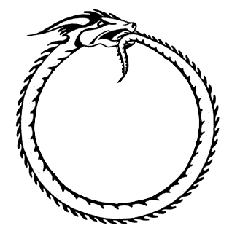
Chapter 7 Recursion(递归)

Slide 2

Outline
Triangular Numbers(三角形数)
Factorials（阶乘）
Anagrams（由改变字母顺序而构成的字）
A Recursive Binary Search（递归版的二分查找）
The Towers of Hanoi（汉诺塔）
Mergesort（归并排序）
Eliminating Recursion*
Some Interesting Recursive*
Applications*

Slide 3


What is recursion?
A programming technique in which a method (function) calls itself.
One of the most interesting, and one of the most surprisingly effective, techniques in programming.
Provides a unique conceptual framework (概念框架)for solving many problems.

Slide 4
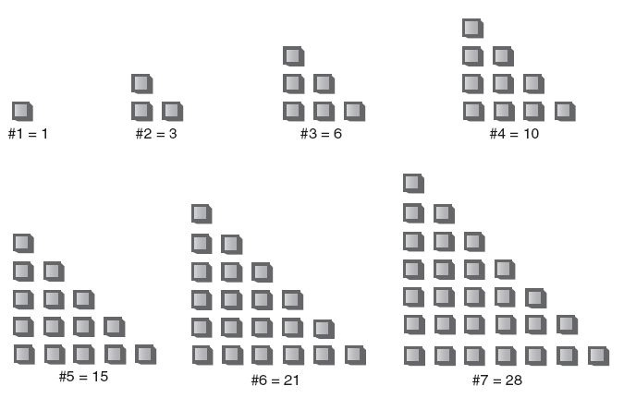
Triangular Numbers
1, 3, 6, 10, 15, 21, …
Can you find the next member of this series?
The numbers in this series are called triangular numbers

Slide 5
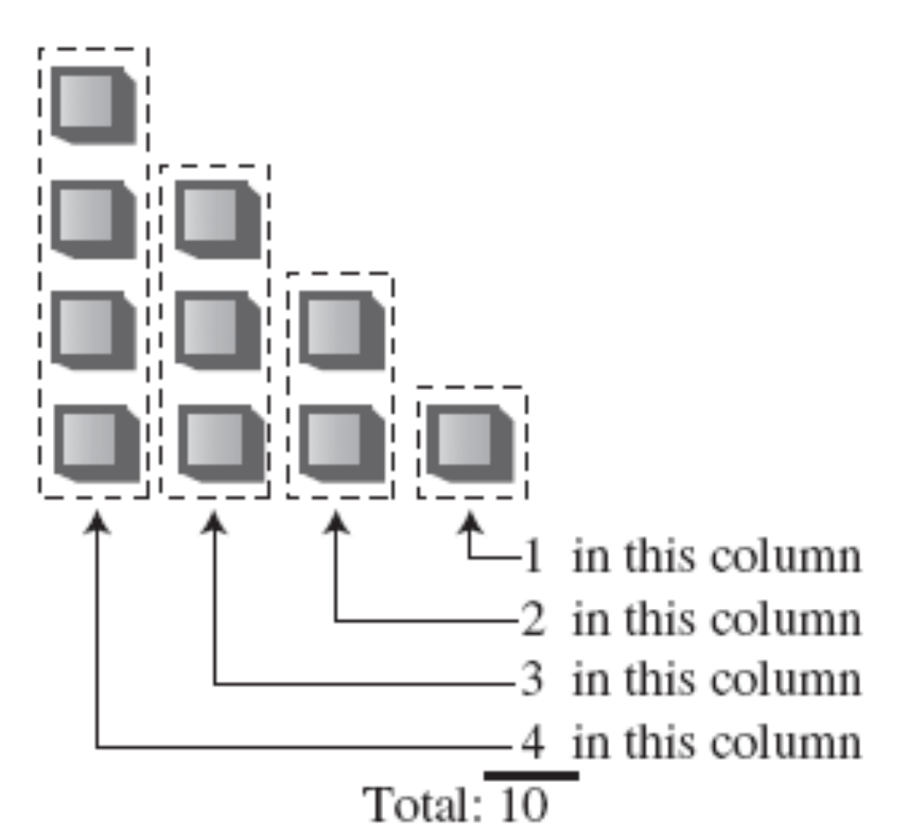
Triangular Numbers
Finding the nth Term Using a Loop
int triangle(int n)
{
int total = 0;
while(n > 0) // until n is 1
{// add n (column height) to total
total = total + n;
--n; // decrement column height
}
return total;
}

Slide 6
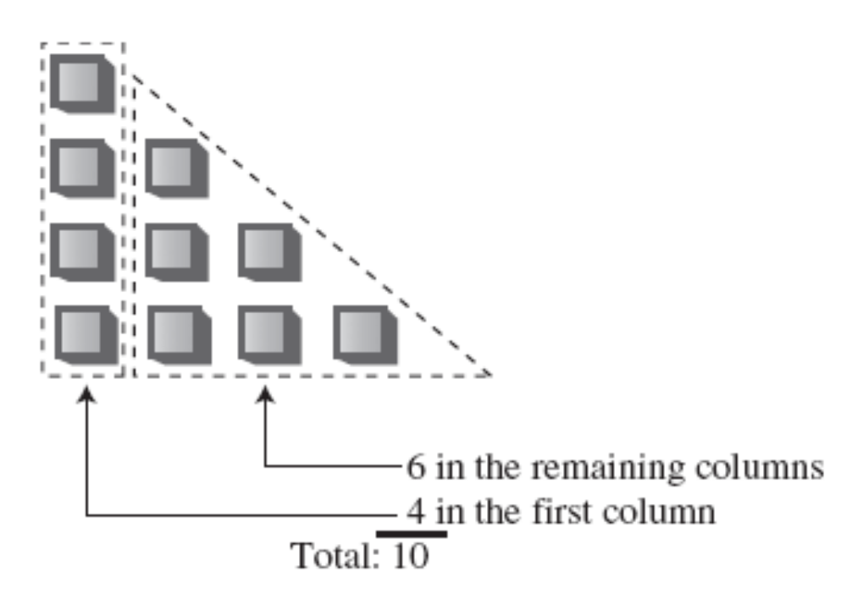
Triangular Numbers
Finding the nth Term Using Recursion
第n项可看成是下面两部分之和：
1. The first (tallest) column, which has the value n.
2. The sum of all the remaining columns.

Slide 7
Triangular Numbers
Finding the Remaining Columns
int triangle(int n)
{
return( n + sumRemainingColumns(n) ); // (incomplete version)
}
It looks like writing the sumRemainingColumns() method is just as hard as writing the triangle() method in the first place.
int triangle(int n)
{
return( n + sumAllColumns(n-1) ); // (incomplete version)
}
The sumAllColumns() method is doing exactly the same
thing the triangle() method is.

Slide 8
Triangular Numbers
Why not use the triangle() method itself, instead of some other method?
int triangle(int n)
{
return( n + triangle(n-1) ); // (incomplete version)
}
Method的调用是把程序运行控制权转移到Method的起点。某个Method控制权的获得可能是来自Method内部或外部。

Slide 9
Triangular Numbers
Passing the Buck（“把责任推给另一个人 or 踢皮球”）
This process continues with each person passing the buck to another one.
Where does this buck-passing end?
Someone at some point must be able to figure out (算出)an answer that doesn’t involve asking another person to help. If this didn’t happen, there would be an infinite (无限)chain of people asking other people questions.
In the case of triangle(), this would mean the method calling itself over and over in an infinite series that would eventually crash the program.

Slide 10
Triangular Numbers
The Buck Stops Here
int triangle(int n)
{
if(n==1)
return 1;
else
return( n + triangle(n-1) );
}
The condition that leads to a recursive method returning without making another recursive call is referred to as the base case(基元).

Slide 11
Triangular Numbers
The triangle.java Program
The main() routine prompts the user for a value for n, calls triangle(), and displays the return value. The triangle() method calls itself repeatedly to do all the work.
Formula: nth triangular number = (n²+n)/2

Slide 12
What’s Really Happening?
public static int triangle(int n)
{
System.out.println(“Entering: n=” + n);
if(n==1)
{
System.out.println(“Returning 1”);
return 1;
}
else
{
int temp = n + triangle(n-1);
System.out.println(“Returning ” + temp);
return temp;
}
}
We’ll insert some output statements to keep track of the arguments and return values:

Slide 13
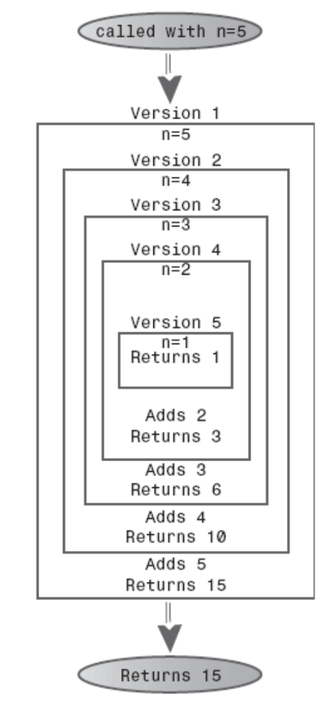
Each time the triangle() method calls itself, its argument, which starts at 5, is reduced by 1.
The method plunges down into(钻入) itself again and again until its argument is reduced to 1.
Then it returns. This triggers an entire series of returns. The method rises back up, phoenix-like, out of the discarded versions of itself.
Each time it returns, it adds the value of n it was called with to the return value from the method it called.

Slide 14
Triangular Numbers
Characteristics of Recursive Methods
（递归方法的特征）
The key features common to all recursive routines:
• It calls itself.
• When it calls itself, it does so to solve a smaller problem.
• There’s some version of the problem that is simple enough that the routine can solve it, and return, without calling itself.

Slide 15
Triangular Numbers
Is Recursion Efficient?（递归高效吗？）
Control must be transferred
The arguments to the method and the address to which the method should return must be pushed onto an internal stack so that the method can access the argument values and know where to return.
Recursion is usually used because it simplifies a problem conceptually, not because it’s inherently more efficient.

Slide 16
Triangular Numbers
Mathematical Induction（数学归纳法）
Using induction, we could define the triangular numbers mathematically by saying：
tri(n) = 1 if n = 1
tri(n) = n + tri(n–1) if n > 1
Defining something in terms of itself may seem circular, but in fact it’s perfectly valid (provided there’s a base case).

Slide 17
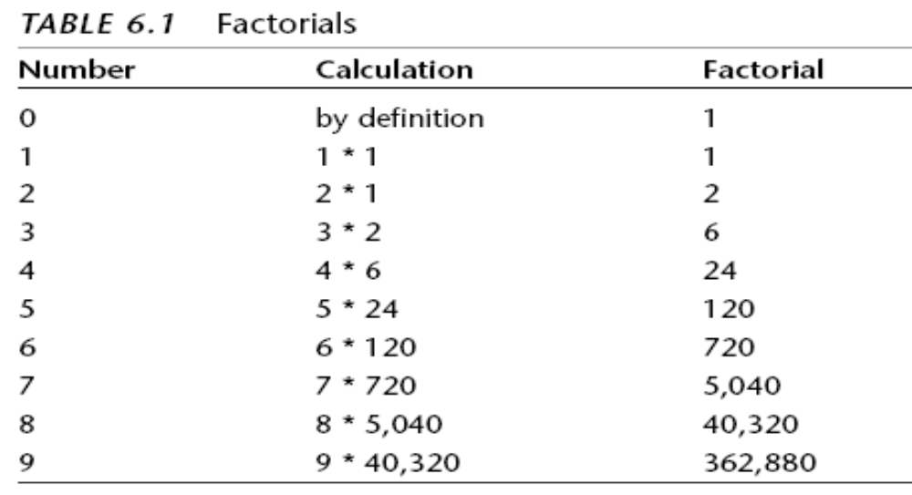
Factorials（阶乘）
The factorial of 0 is defined to be 1. Factorial numbers grow large very rapidly.

Slide 18
Factorials
int factorial(int n)
{
if(n==0) // base condition
return 1;
else
return (n * factorial(n-1) );
}
There are only two differences between factorial() and triangle().
First, factorial() uses a * instead of a + in the expression n * factorial(n-1)
Second, the base condition occurs when n is 0, not 1.

Slide 19
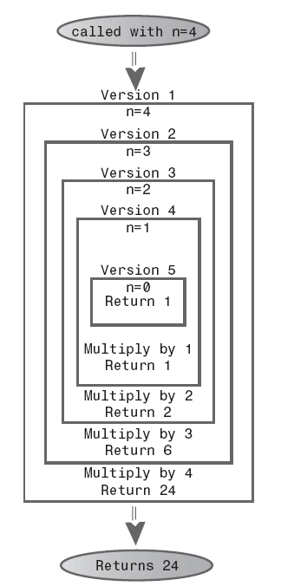
Factorials
The recursive factorial() method.
Examples using recursion：
求一个数的乘方
求两个整数的最大公约数
…
But they probably wouldn’t be used in practice because a loop-based approach is more efficient.
Notes:
两个整数的最大公约数是能够同时整除它们的最大的正整数。辗转相除法基于如下原理：两个整数的最大公约数等于其中较小的数和两数的差的最大公约数。例如，252和105的最大公约数是21（252 = 21 × 12；105 = 21 × 5）；因为252 − 105 = 147，所以147和105的最大公约数也是21。在这个过程中，较大的数缩小了，所以继续进行同样的计算可以不断缩小这两个数直至其中一个变成零。这时，所剩下的还没有变成零的数就是两数的最大公约数。由辗转相除法也可以推出，两数的最大公约数可以用两数的整数倍相加来表示，如21 = 5 × 105 + (−2） × 252。这个重要的等式叫做贝祖等式。
unsigned gcd ( unsigned m,unsigned n )
{
unsigned temp;
if (m<n)
{
temp=m;
m=n;
n=temp;
}
if ( m % n == 0)
{
return n;
}
else
{
return gcd ( n,m % n) ;
}
}

Slide 20

Anagrams
Anagrams
All possible permutations(排列) of a specified word.
E.g. Anagramming cat would produce
• cat
• cta
• atc
• act
• tca
• tac

Slide 21
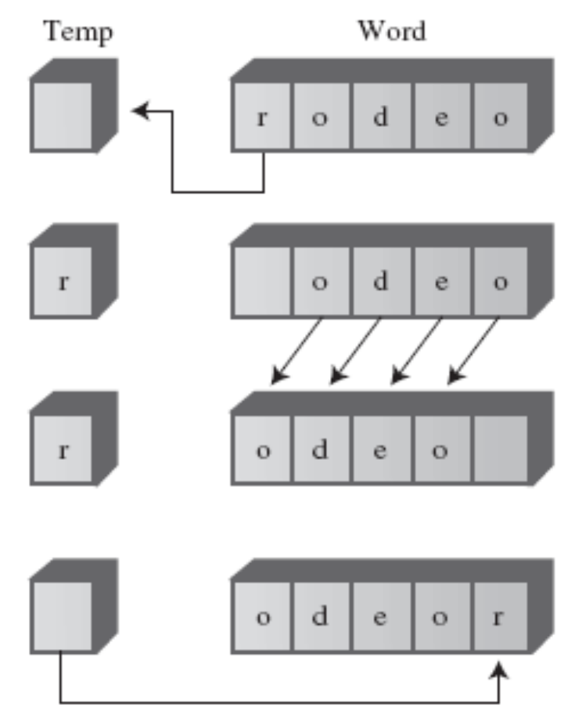
Anagrams
How would you write a program to anagram a word?
Here’s one approach. Assume
the word has n letters.
1. Anagram the rightmost n-1 letters.
2. Rotate all n letters.
3. Repeat these steps n times.
To rotate the word means to shift all the letters one position left, except for the leftmost letter, which “rotates” back to the right

Slide 22
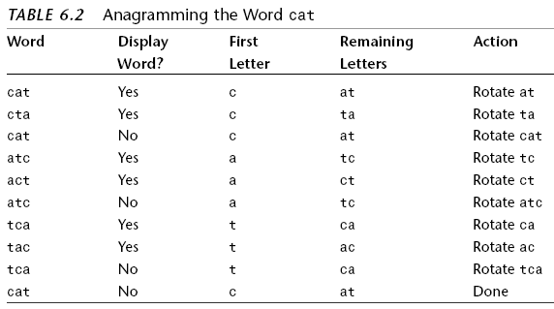
Anagrams
Rotating the word n times gives each letter a chance to begin the word. While the selected letter occupies this first position, all the other letters are then anagrammed (arranged in every possible position).

Slide 23
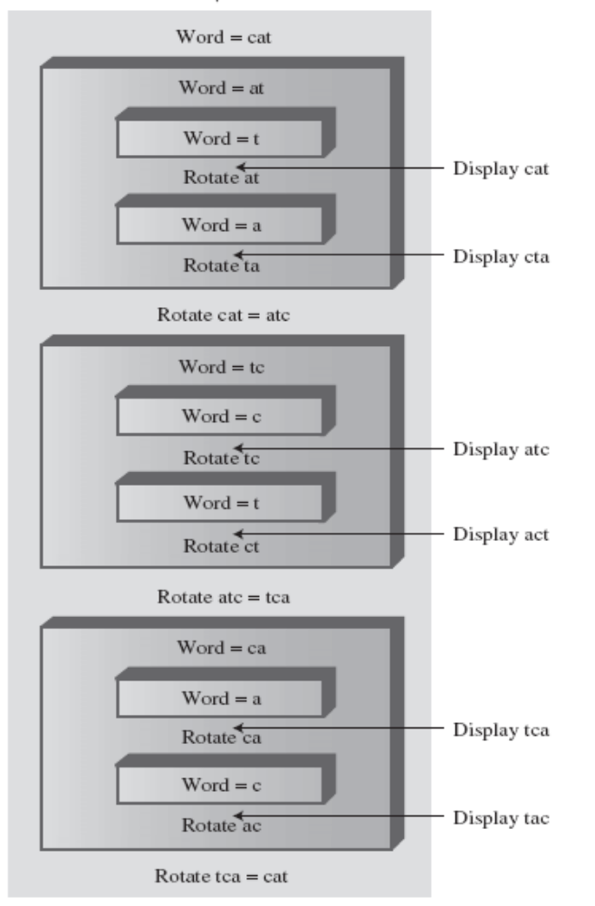
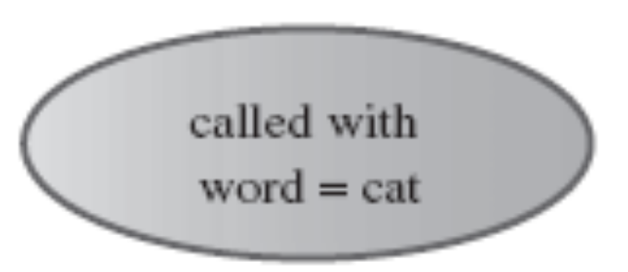
How do we anagram the rightmost n-1 letters?
By calling ourselves.

Slide 24
Anagrams
The base case occurs when the size of the word to be anagrammed is only one letter.
public static void doAnagram(int newSize)
{
if(newSize == 1) // if too small,
return; // go no further
for(int j=0; j<newSize; j++) // for each position,
{
doAnagram(newSize-1); // anagram remaining
if(newSize==2) // if innermost,
displayWord(); // display it
rotate(newSize); // rotate word
}
}

Slide 25
A Recursive Binary Search
In the loop-based method, we change lowerBound or upperBound to specify a new range and then cycle through the loop again. Each time through the loop we divide the range (roughly) in half.
In the recursive approach, instead of changing lowerBound or upperBound, we call find() again with the new values of lowerBound or upperBound as arguments. The loop disappears, and its place is taken by the recursive calls. Here’s how that looks:

Slide 26
private int recFind(long searchKey, int lowerBound,
int upperBound){
int curIn = (lowerBound + upperBound ) / 2;
if(a[curIn]==searchKey)
return curIn; // found it
else if(lowerBound > upperBound)
return nElems; // can’t find it
else{ // divide range
if(a[curIn] < searchKey) // it’s in upper half
return recFind(searchKey, curIn+1, upperBound);
else // it’s in lower half
return recFind(searchKey, lowerBound, curIn-1);
} // end else divide range
} // end recFind()

Slide 27
A Recursive Binary Search
The class user, represented by main(), may not know how many items are in the array when it calls find(), and in any case shouldn’t be burdened with having to know what values of upperBound and lowerBound to set initially.
public int find(long searchKey)
{
return recFind(searchKey, 0, nElems-1);
}
LISTING 6.3 The binarySearch.java Program

Slide 28
A Recursive Binary Search
Divide-and-Conquer (分而治之) Algorithms
1、将一个大问题分解为两个较小的问题，然后分别解决之。
2、对于每个较小问题，解决方法是相同的：你继续将其分解为两个更小规模的问题.
3、上述1、2步骤持续进行，直至可以立即得解的粒度。

Slide 29
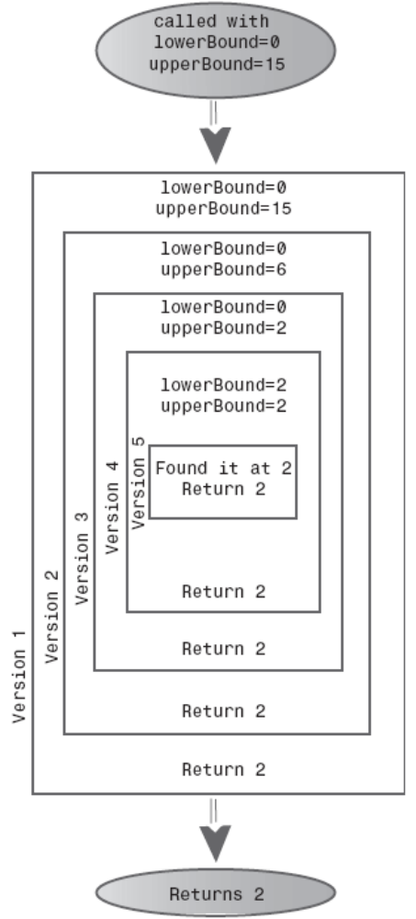
The recursive binarySearch() method.

Slide 30
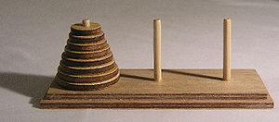
The Towers of Hanoi
The Towers of Hanoi
Ancient myth that in India or Vietnam

Slide 31
The Towers of Hanoi
The Towers Workshop Applet
There are three ways to use the Workshop applet:
• You can attempt to solve the puzzle manually, by dragging the disks from tower to tower.
• You can repeatedly press the Step button to watch the algorithm solve the puzzle. At each step in the solution, a message is displayed, telling you what the algorithm is doing.
• You can press the Run button and watch the algorithm solve the puzzle with no intervention on your part; the disks zip back and forth between the posts.

Slide 32
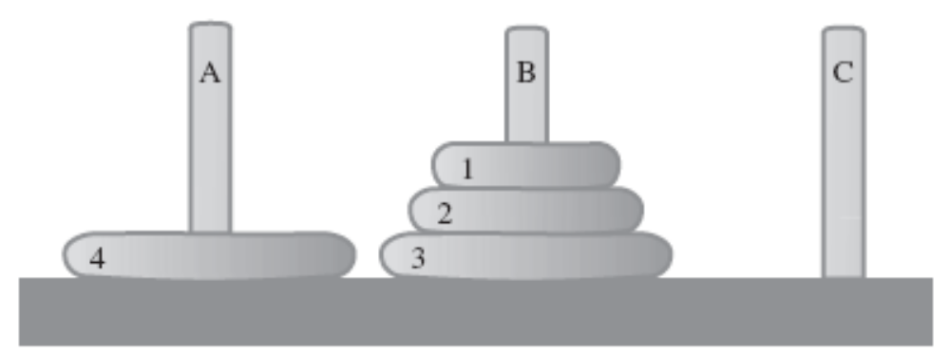
The Towers of Hanoi
Moving Subtrees（子树）
The only way to transfer a larger disk from one tower to another: All the smaller disks must be placed on an intermediate tower, where they naturally form a subtree.

Slide 33
The Towers of Hanoi
The Recursive Algorithm
The solution to the Towers of Hanoi puzzle can be expressed recursively using the notion of subtrees. Suppose you want to move all the disks from a source tower (call it S) to a destination tower (call it D). You have an intermediate tower available (call it I). Assume there are n disks on tower S.
Here’s the algorithm:
1. Move the subtree consisting of the top n-1 disks from S to I.
2. Move the remaining (largest) disk from S to D.
3. Move the subtree from I to D.
当然，此方案并未解决如何将subtree移到I的问题（因为我们不可能一次移动subtree到另外一个柱子）。
It can be done with the same three steps as moving four disks.

Slide 34
The Towers of Hanoi
How do you move a subtree of two disks from A to C?
Move the subtree consisting of only one disk (1) from A to B. This is the base case: When you’re moving only one disk, you just move it; there’s nothing else to do. Then move the larger disk (2) from A to C, and replace the subtree (disk 1) on it.

Slide 35
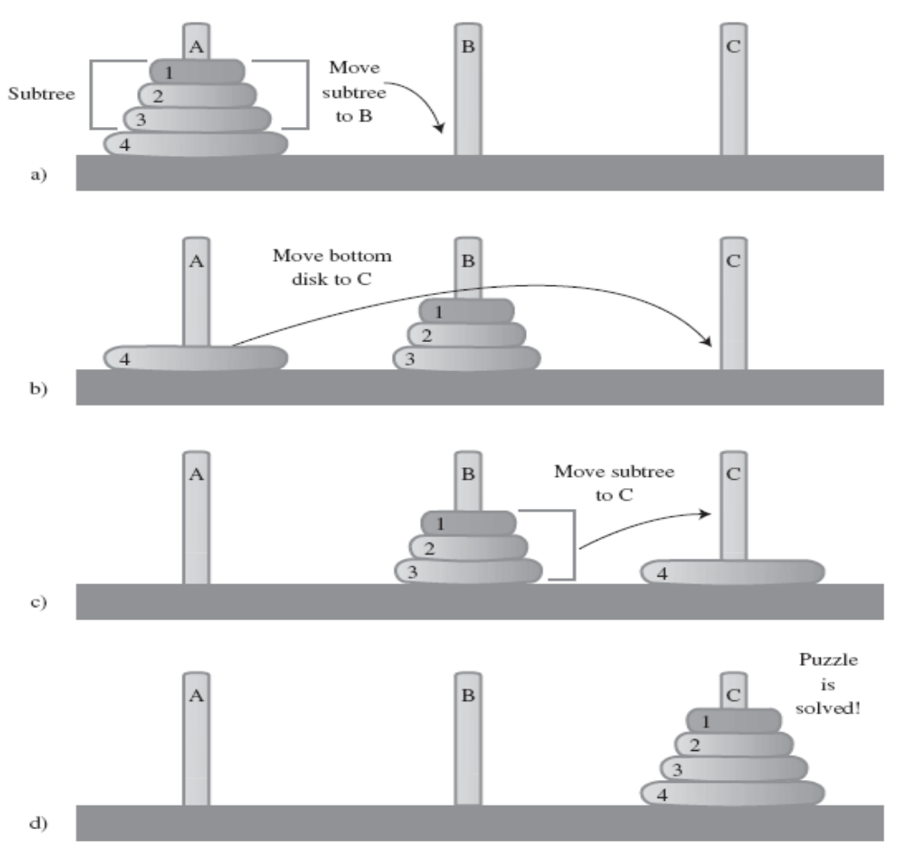

Slide 36
The Towers of Hanoi
The towers.java Program
The towers.java program solves the Towers of Hanoi puzzle using this recursive approach. It communicates the moves by displaying them; this approach requires much less code than displaying the towers. It’s up to the human reading the list to actually carry out the moves.

Slide 37
Mergesort(归并排序)
This is a much more efficient sorting technique than those we saw in Chapter 3, “Simple Sorting,” at least in terms of speed.
Simple Sorting
O(N²)
Mergesort
O(NlogN)
The downside of the mergesort is that it requires an additional array in memory.

Slide 38
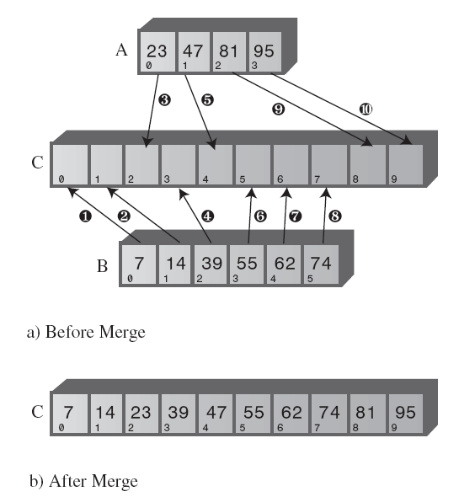
Mergesort
Merging Two Sorted Arrays
The heart of the mergesort algorithm is the merging of two already-sorted arrays.
LISTING 6.5 The merge.java Program

Slide 39
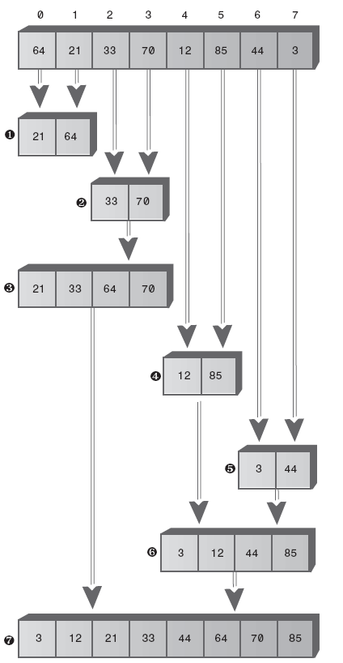
Mergesort
Sorting by Merging

Slide 40
Mergesort
The MergeSort Workshop Applet
The mergeSort.java Program

Slide 41
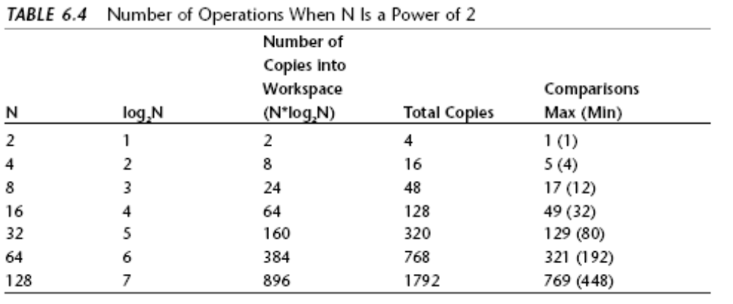
Mergesort
Efficiency of the mergesort

Slide 42
Eliminating Recursion
有些问题用递归求解代价较大，例如三角形数、阶乘问题，它们直接用循环求解更为简单，效率也更高。
但有些问题（例如分治法一类问题：归并排序）则适合用递归算法。
作为概念设计工具，递归较为简洁。但出于运行效率考虑，常常需要把递归算法转化为非递归算法。可以借助Stack达到这一目的。

Slide 43
Eliminating Recursion
递归和栈
  它们是紧密联系的。事实上，大部分的编译器都是使用栈来实现方法的调用（当然也包括递归）。
  当调用一个方法的时候，编译器会把这个方法的所有参数及其返回地址(这个方法返回时控制到达的地方)都压入栈中，然后把控制转移给这个方法。
  当这个方法返回的时候，这些值退栈。参数消失了，并且控制权重新回到返回地址处。

Slide 44
Eliminating Recursion
用栈来模拟递归
int triangle(int n){
if ( n==1)
return 1;
else
return( n+triangle(n-1));
}
（1）Stack用来保存参数和返回地址。
（2）每层调用视为一次push，每次返回视为一次pop()

Slide 45
Eliminating Recursion
triangle()方法的两类操作
  执行算术运算来计算三角数组。这包括检查n是否为1，以及给上一次递归调用的结果加n。
  执行控制权转移、参数的读取以及返回地址。
写在一个switch中就包括以下几种case
  当一个方法被调用时，它的参数以及返回地址被压入一个栈中。
  这个方法可以通过获取栈顶元素的值来访问它的参数。
  当这个方法要返回的时候，它查看栈以获得返回地址，然后这个地址以及方法的所有参数
  退栈，并且销毁。

Slide 46
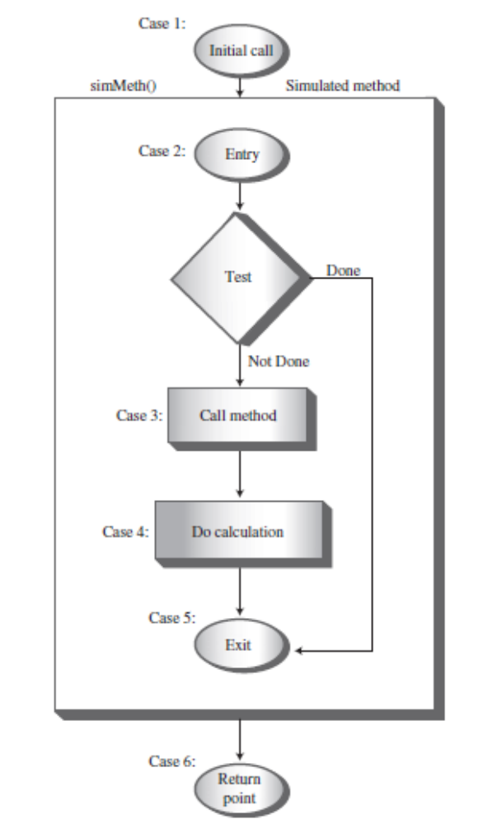
Eliminating Recursion
  while(true)
  switch(codePart){
  case 1:…break;// initial call，push
  case 2:…break;// method entry(n=1 or other)，peek
  case 3:…break;// method call, push，codePart变2
  case 4:…break;// calculation，peek
  case 5:…break;// method exit，peek，pop
  case 6:…break;// return point
  }
  }

Slide 47
Eliminating Recursion
所有递归程序理论上都能用栈来实现为非递归的算法。
某些算法的转化也可以完全不用栈，而使用一个简单的循环。但是，在更复杂的算法中必须要保留栈。
通常，需要根据试验来判断，究竟是用递归或基于栈的方法，还是一个简单的循环方法，哪一个更有效率(或者更实用)。

Slide 48

一些有趣的递归程序
求一个数的乘方（把O(N)变O(log(N))）
  Y=a^{x}
  ^{基元？}
  ^{推卸责任？}
X=1的时候 Y=a
X>1的时候 Y=(a^{x/2})²
如果x不为偶数呢？
Notes:
public class MyClass {
int val;
public static void main(String[] args){
int a = 3;
int x = 8;
int r = power(a,x);
System.out.println(r);
}
private static int power(int a, int x) {
int r = 1;
if(x % 2 == 1){
r = a;
x--;
}else if(x == 1){
return a;
}else if(x == 0){
return 1;
}
return r*power(a,x/2)*power(a,x/2);
}
}

Slide 49
一些有趣的递归程序
背包问题（Knapsack Problem）
  给定一堆重量不等的货物（不能拆散），如何往一个背包里放入指定重量的货物（假设为W）？
思路：先任意取一个货物w_{i}放入背包W，则本问题可以分解为？
基元：W= w_{i} or W< w_{i}
推卸责任：剩余空间和其余的货物作为参数交给下一版本的算法处理。
Notes:
import java.util.Stack;
public class MyClass {
static int[] goods = {11,8,7,6,5};
static Stack<Integer> s = new Stack<Integer>();
public static void main(String[] args){
knapsack(16,goods);
}
private static boolean knapsack(int w,int[] remains){
for(int i = 0; i < remains.length; i++){
int g = remains[i];
s.push(g);
if(g == w){
displayAnswer();
return true;
}
if(knapsack(w-g,minus(remains,g))){
return true;
}
s.pop();
}
return false;
}
private static void displayAnswer() {
for(Integer i : s){
System.out.print(i + " ");
}
System.out.println();
}
private static int[] minus(int[] remains, int g) {
int[] result = new int[remains.length - 1];
int k = 0;
for(int i : remains){
if(i == g){
continue;
}
result[k++] = i;
}
return result;
}
}

Slide 50
一些有趣的递归程序
组合问题（类似anagram？）
Notes:
public class MyClass {
int val;
public static void main(String[] args){
int a = 3;
int x = 8;
int r = power(a,x);
System.out.println(r);
}
private static int power(int a, int x) {
int r = 1;
if(x % 2 == 1){
r = a;
x--;
}else if(x == 1){
return a;
}else if(x == 0){
return 1;
}
return r*power(a,x/2)*power(a,x/2);
}
}

Slide 51
Summary
一个递归的方法每次用不同的参数值反复调用自身。
某种参数值使递归的方法返回，而不再调用自身。这称为基元情况。
当递归方法返回时，递归过程通过逐渐完成各层方法实例的未执行部分，而从最内层返回 到最外层的原始调用处。
三角数字和阶乘都可以通过递归的方法或者简单的循环方法来实现。
一个单词的全排列(它的n个字母的所有可能排列)可以通过反复地轮换它的字母以及全 排列它最右边的n-1个字母来递归得到。

Slide 52
二分查找可以通过检查查找关键字在有序序列的哪一半，然后在这一半做相同的事情，这些都可以用递归实现。
汉诺塔难题可以递归来解决:把除了最低端盘子外的所有盘子形成的子树移动到一个中介塔座上，然后把最低端的盘子移到目标塔座上，最终把那个子树移动到目标塔座上。
归并两个有序数组意思是创建第三个数组，这个数组按顺序存储从这两个有序数组中取到的所有数据项。
在归并排序中，一个大数组的单个数据项的子数组归并为两个数据项的子数组，然后两个数据项的子数组归并为4个数据项的子数组，如此下去直到所有的数组数据项有序。归并排序需要O(N*IogN)时间。

Slide 53
归并排序需要一个大小等于原来数组的工作空间。
对于三角数字、阶乘、单词字母全排列以及二分查找，它们的递归的方法只包含一次对自身的调用。(在二分查找的代码中显示有两次，但是在任何给定代码的运行中只有一次自身的调用执行了。)
对于汉诺塔和归并排序问题，它们的递归的方法包括两次递归调用。
任何可以用递归完成的操作都可以用一个栈来实现。
递归的方法可能效率低。如果是这样的话，有时可以用一个简单循环或者是一个基于栈的方法来替代它。

Slide 54
The End

